Slide 1
Decision Tree
One of the most useful Algorithm

Slide 2
Decision Tree
Decision tree is a diagram or chart that people use to determine a course of action or show a statistical probability. ... Each branch of the decision tree represents a possible decision, outcome, or reaction. The farthest branches on the tree represent the end results.

Slide 3
Types Of Decision Trees
Categorical Variable Decision Tree: Decision Tree which has a categorical target variable then it called a Categorical variable decision tree.
Continuous Variable Decision Tree: Decision Tree has a continuous target variable then it is called Continuous Variable Decision Tree.

Slide 4
Different Nodes
There are three different types of nodes: chance nodes, decision nodes, and end nodes.
Chance node, represented by a circle, shows the probabilities of certain results.
Decision node, represented by a square, shows a decision to be made
An end node shows the final outcome of a decision path.

Slide 5
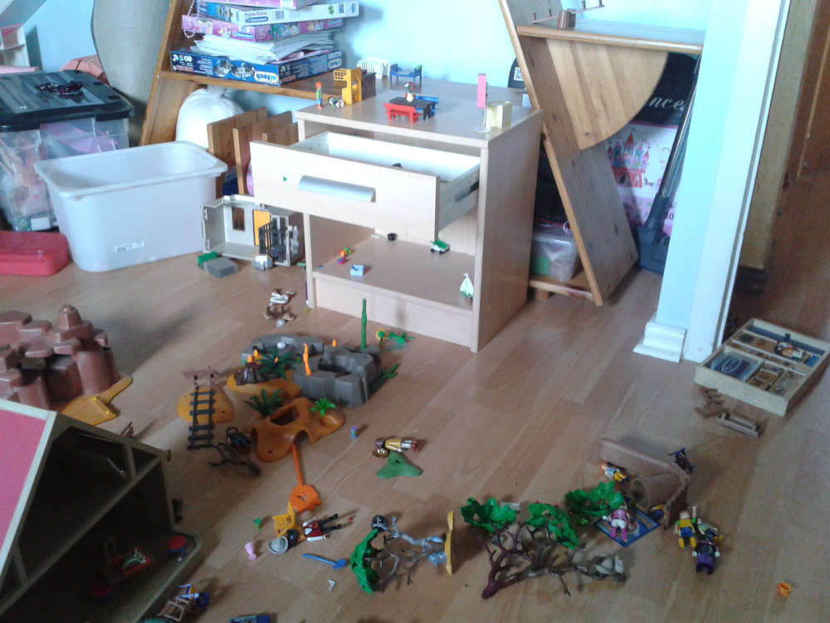

Slide 6
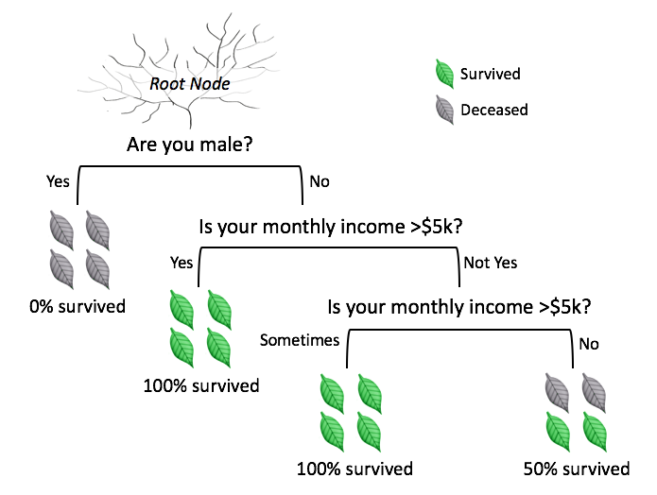
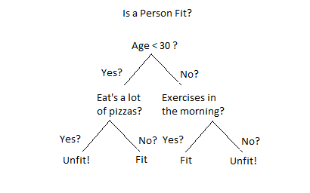

Slide 7
Algorithms
The basic algorithm used in decision trees is known as the ID3 (by Quinlan) algorithm. The ID3 algorithm builds decision trees using a top-down, greedy approach. Briefly, the steps to the algorithm are: - Select the best attribute → A - Assign A as the decision attribute (test case) for the NODE.
ID3 (Iterative Dichotomiser 3) is an algorithm invented by Ross Quinlan used to generate a decision tree from a dataset.

Slide 8
Entropy
Entropy, as it relates to machine learning, is a measure of the randomness in the information being processed. The higher the entropy, the harder it is to draw any conclusions from that information. Flipping a coin is an example of an action that provides information that is random
Logarithm of fractions gives a negative value and hence a '-' sign is used in entropy formula to negate these negative values. The maximum value for entropy depends on the number of classes. The feature with the largest information gain should be used as the root node to start building the decision tree.

Slide 9
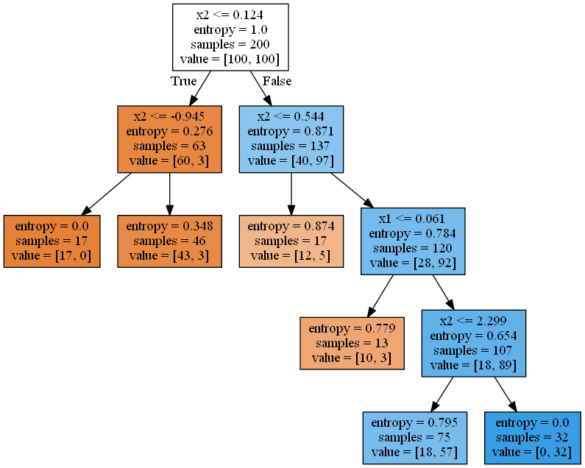

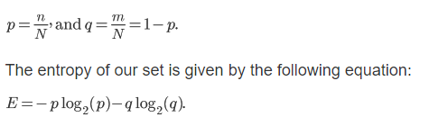

Slide 10
gini
Gini index or Gini impurity measures the degree or probability of a particular variable being wrongly classified when it is randomly chosen. But what is actually meant by 'impurity'? If all the elements belong to a single class, then it can be called pure.
Gini measurement is the probability of a random sample being classified incorrectly if we randomly pick a label according to the distribution in a branch.

Slide 11
Gini index measures the extent to which the distribution of income (or, in some cases, consumption expenditure) among individuals or households within an economy deviates from a perfectly equal distribution. A Gini index of zero represents perfect equality

Slide 12
Range of Entropy,Gini Impurity
The range of Entropy lies in between 0 to 1 and the range of Gini Impurity lies in between 0 to 0.5. Hence we can conclude that Gini Impurity is better as compared to entropy for selecting the best features.

